Slide 1
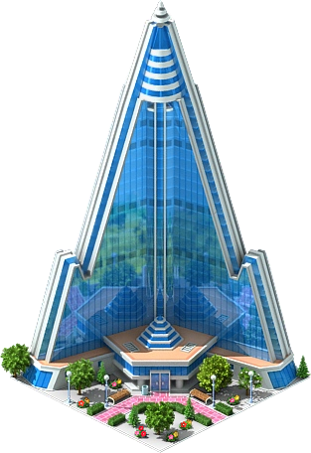
Hotel ryugyong

Slide 2
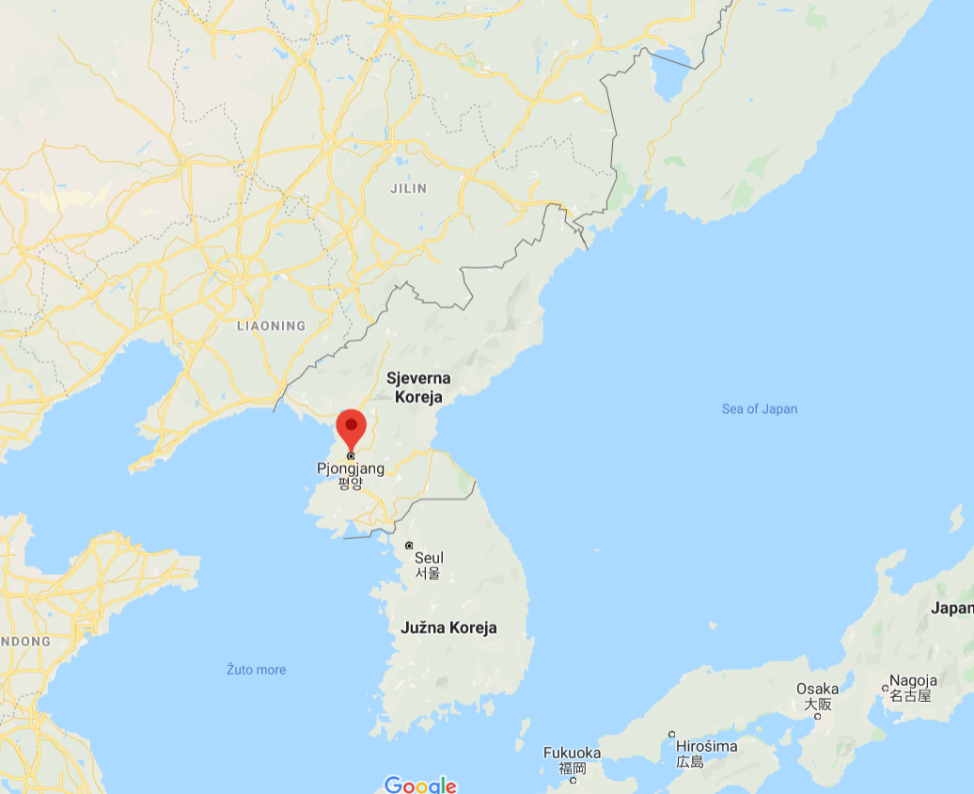
Basic informations
Pyramid-shaped skyscraper in Pyongyang→ North Korea
105 story, 330 metre tall
Ryugyong ="capital of willows"→
historical name for Pyongyang

Slide 3

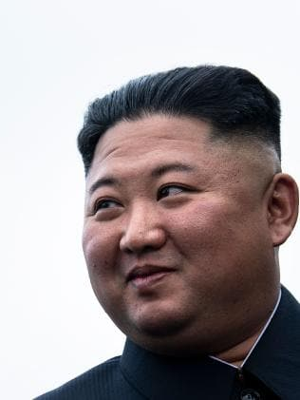
Basic informations
Construction began in 1987
Building started under Kim Il-sung
It is an embarrassment to his grandson Kim Jong-un.
Still unfinished

Slide 4
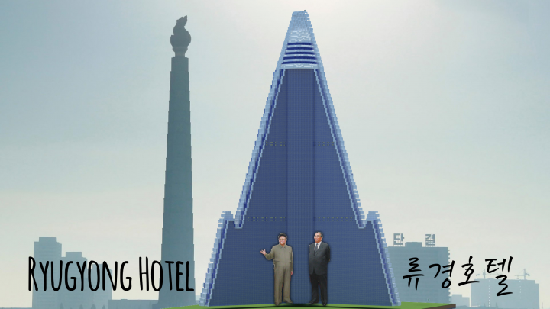
Basic informations
The hotel has been under construction for 33 years
Delayed by famine, economic ruin and the fall of the Soviet empire
Nicknames → “phantom hotel” and “hotel of doom”

Slide 5

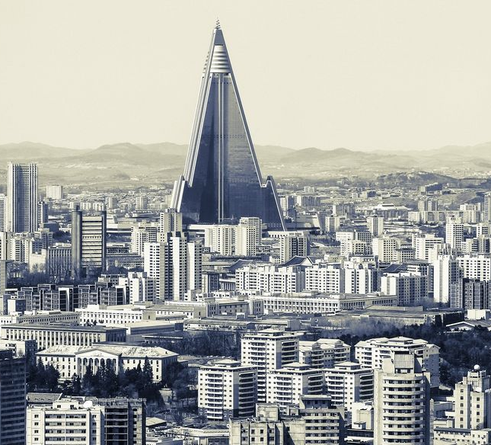
Basic informations
Designed by Baikdoosan Architects & Engineers
Architectural style → Neo-futurism

Slide 6
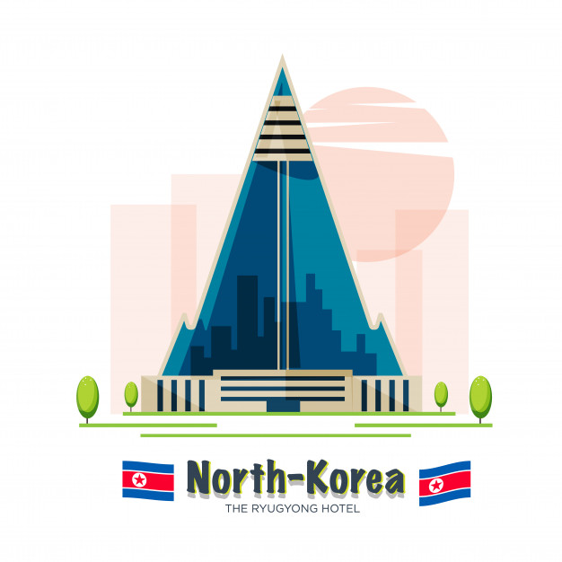
Basic informations
Meant to be a showpiece of North Korea’s “premier restaurants, hotel accommodation, apartments, and business facilities”

Slide 7
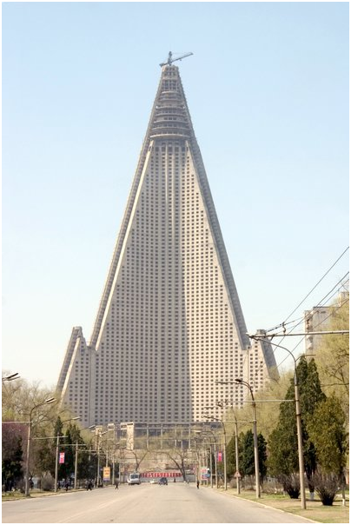
construction
Massive cast concrete floors and pillars
Construction problems → crumbling concrete
The building is structurally good and effective
The building consists of three wings, each measuring 100 metres long, 18 metres wide

Slide 8
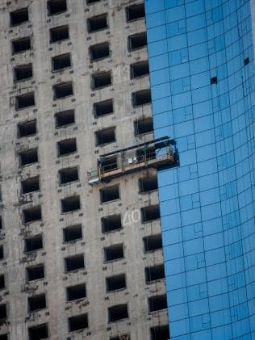
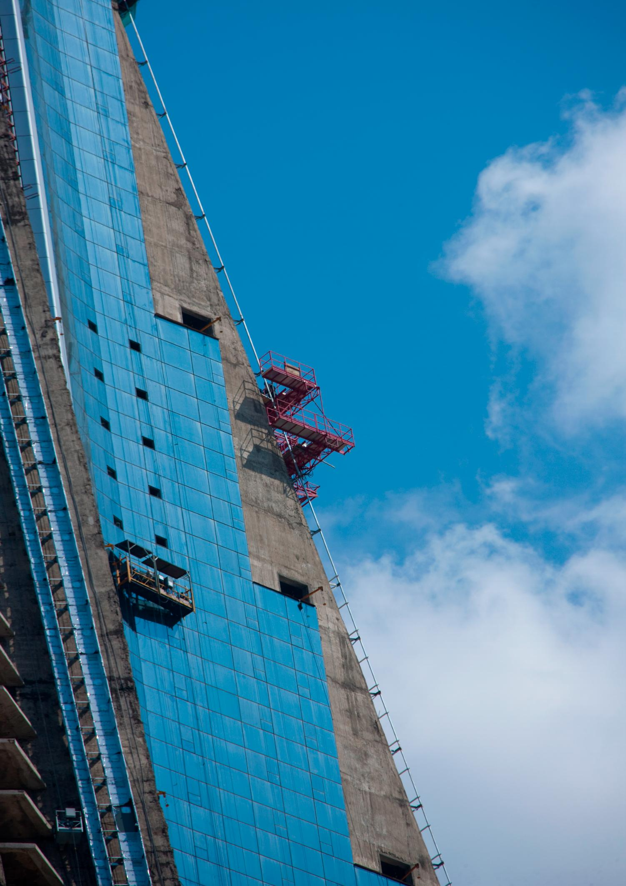
construction
The frame of the construction got finished in1992.
Work restarted in 2008.
Glass panels were added to the exterior in 2011.

Slide 9
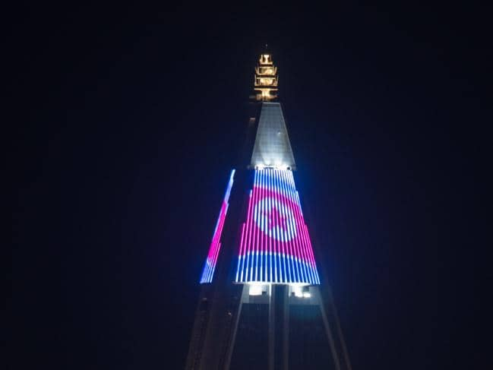
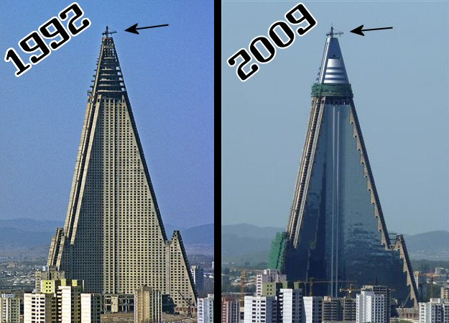
The hotel remains a symbol of its country’s deficiencies
In December 2016, lights were seen shining inside the tower

Slide 10
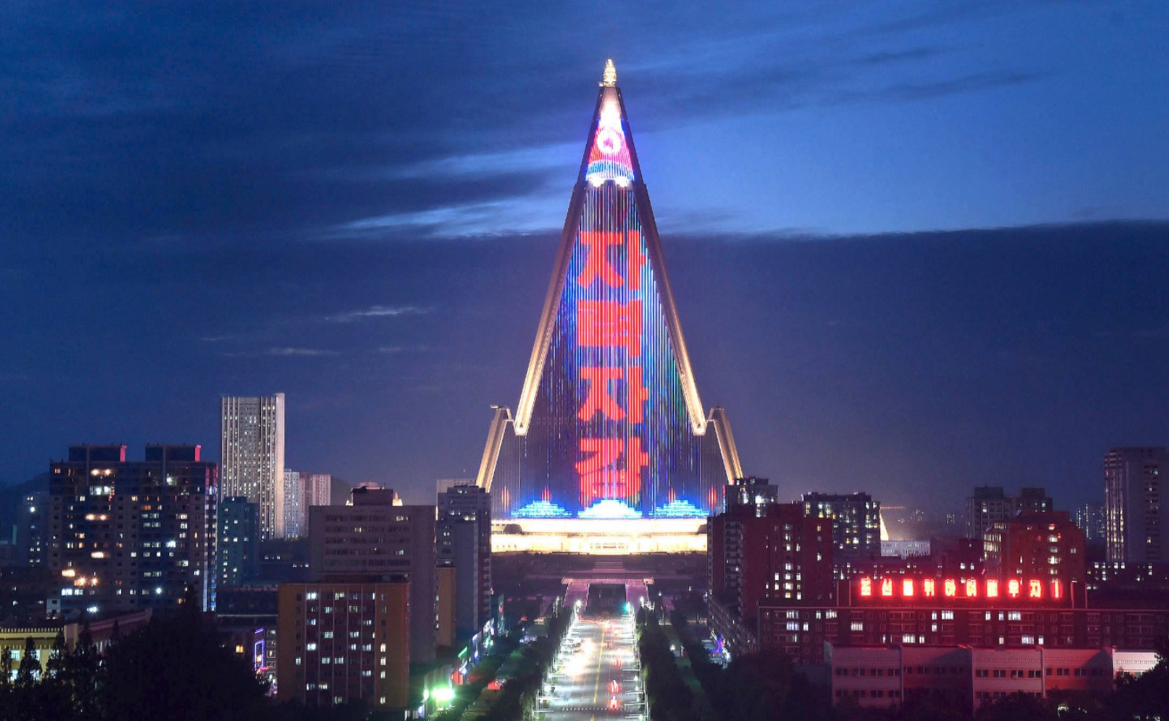
In 2018. an LED display was fitted to one side of the structure, and propaganda videos and light shows are regularly played

Slide 11
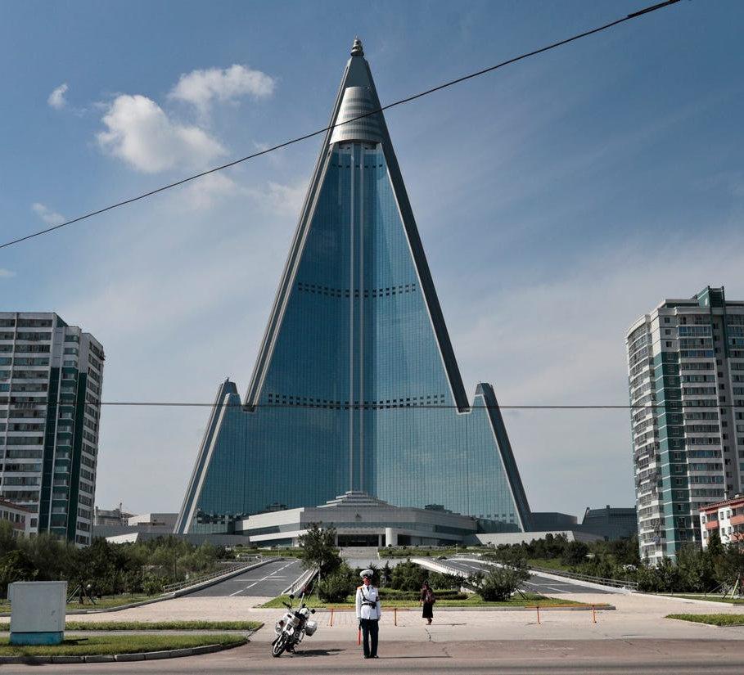
costs
North Korea has spent 750 million $
Today it would cost up to 2 billion $ to finish hotel and make it safe

Slide 12
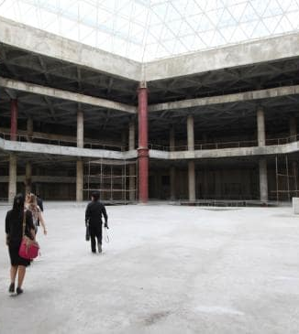
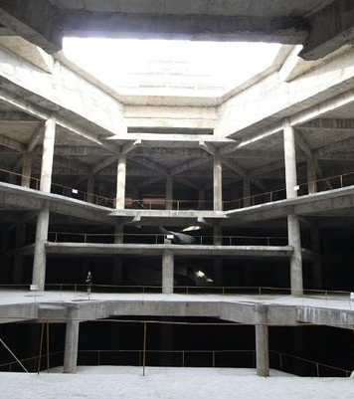
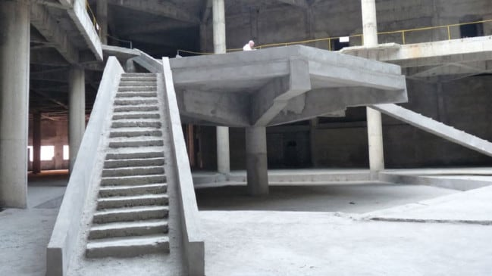
the interior of the building
Inside it remains an eerie concrete ghost tower

Slide 13
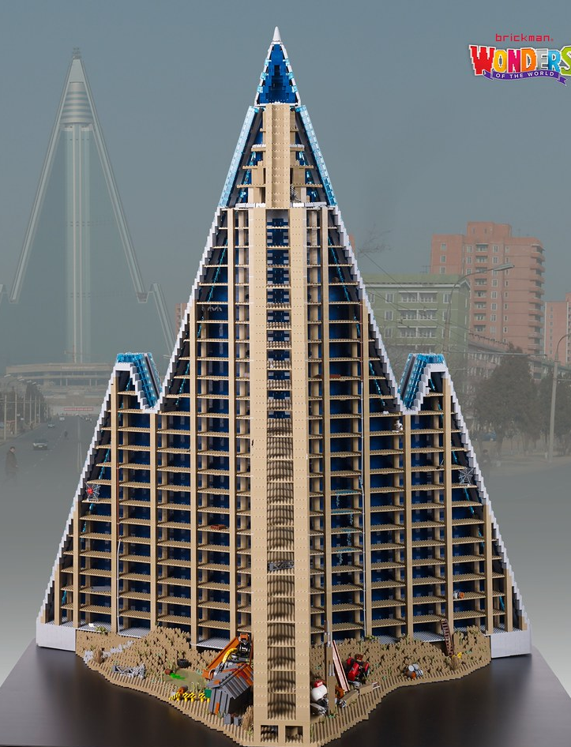

fun facts
The Guinness Book of Records describes the Ryugyong hotel as the world’s tallest empty building
The hotel is opened for the tourist to visit and they can take photos
Ryugyong is believed to have been designed to resemble a mountain rather than a pyramid, as mountains play an important role in the symbolism of the country

Slide 14
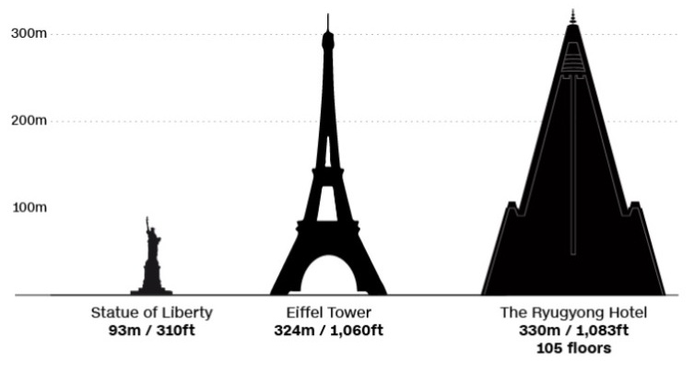
fun facts
With a completion date of 1989, it was intended to be open in time for the 13th World Festival of Youth and Students
If this had taken place, the Ryugyong would have been the tallest hotel in the world at that time

Slide 15
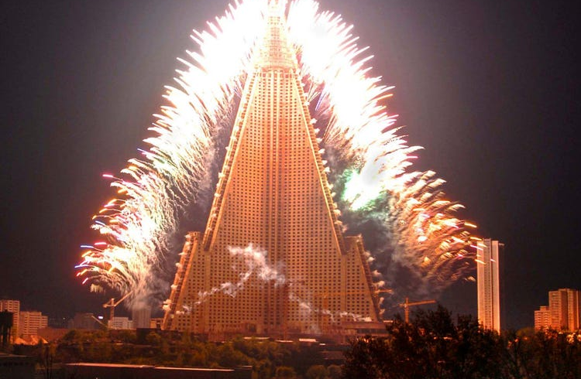
conclusion
Wrong cost estimate → The North Koreans expected the project to bring in foreign investors
The extremely poor quality concrete used in its construction has left the building sagging → massive overhaul
Economic crises and the country tightened policy
All of these things led to the great failure of the project

Slide 16
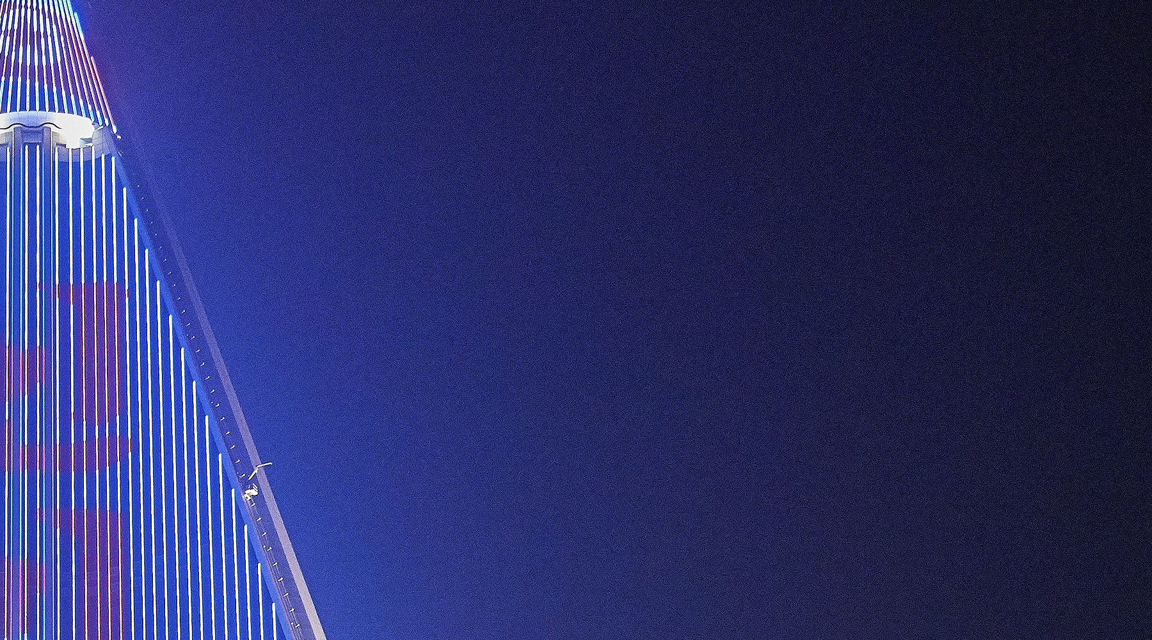
new words
Willow
Vrba
Hotel propasti
Nedostaci
Jeziv
Nalikovati
Raspadajući beton
Nagnuto
Veliki popravak
Hotel of doom
deficiencies
Eerie
To resemble
Crumbling concrete
Sagging
Massive overhaul

Slide 17
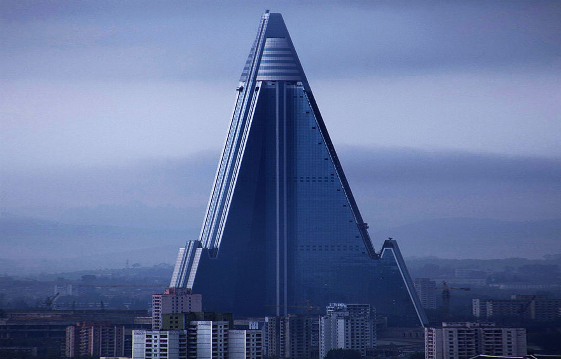
Made by: Veronika Tušek

Slide 18
INSERT THE WORDS FROM THE PRESENTATION INCLUDING THE WORDS FOR : RASPON AND KRUTOST
They announced plans for a radical -------------of the country's political system.
A strong vertical column made of stone, metal, or wood that supports part of a building or stands alone fordecoration is a ---------
Along the river, ------------- remnants of an active trading hub are overtaken by nature.
In building construction, the --------of beams is called "deflection". The amount of deflection varies, based on the beam’s ---------, the ----- between supports, and the load it carries. ---------- is a common problem in older houses

