Slide 1
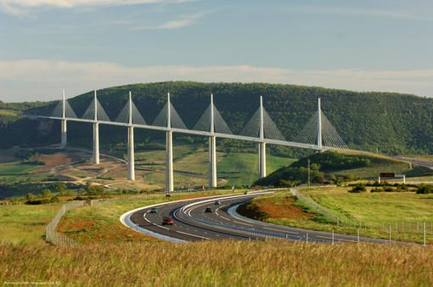
The Millau viaduct
Bastien Pedemarie

Slide 2
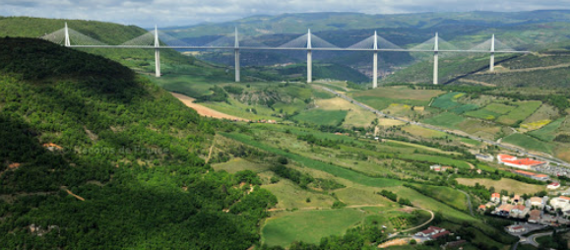
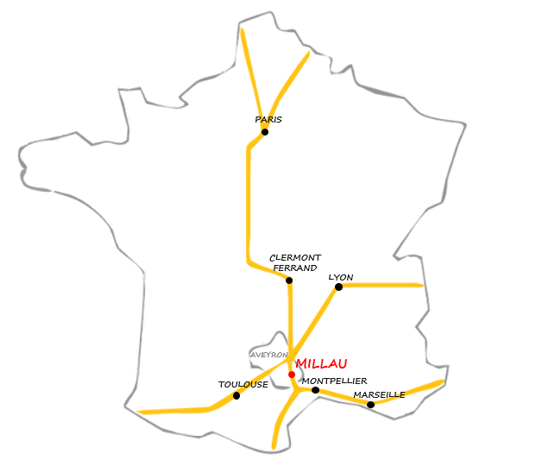
1. History
Gorge valley of the Tarn
Norman Fauster
Michel Virlogeux
Millau’s location

Slide 3
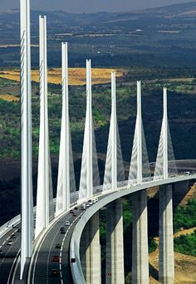
2. Characteristics
Length : 2 460 m
Width : 32 m
Average height of the piles : 170 m
Highest point (with masts) : 343 m
Length of a central span : 342 m

Slide 4
2.1 The footings
Footing thickness : 5 m
Four shafts
footing
shafts

Slide 5
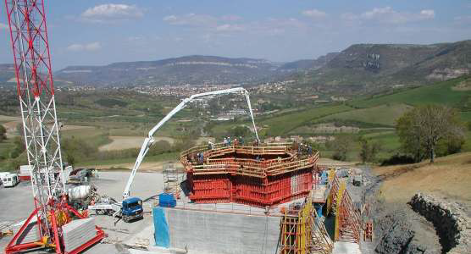
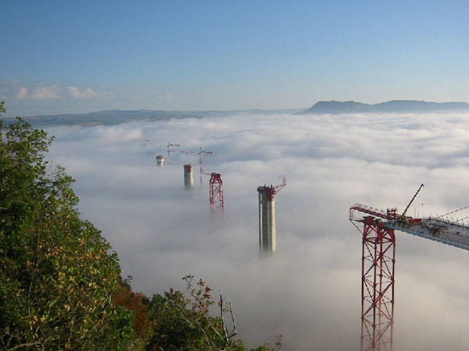
2.2 The piles
Mobile formwork of the pile
7 piles
Each 4 meters, the formwork is elevated
Piles and temporary pylon

Slide 6
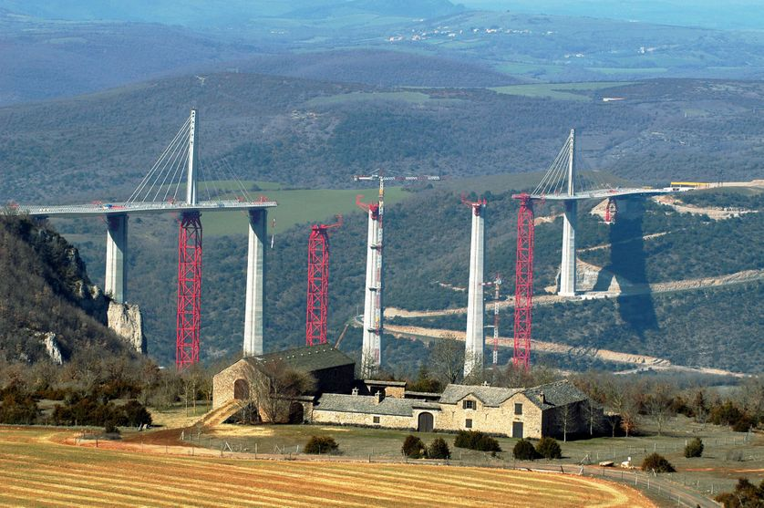
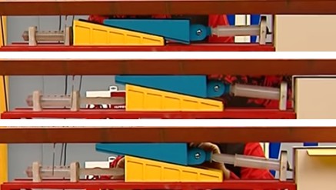
2.3 The deck
The two decks slide on the piles
1. The deck relies on the piles
2. The yellow wedge elevates the deck
3. The blue wedge pushes the deck

Slide 7
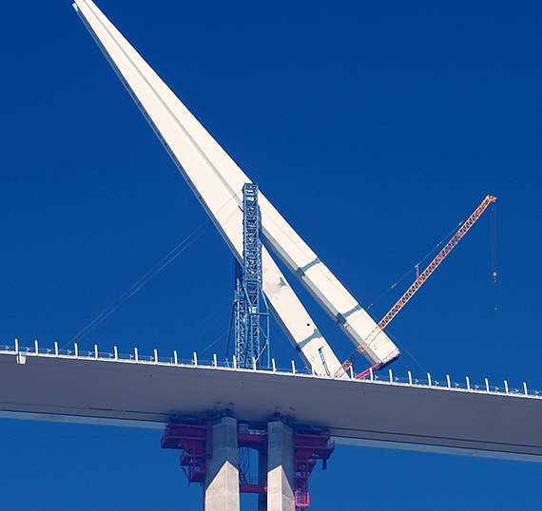
2.4 The masts and expansion joints
The masts is brought then it rotates
Up to 1.2 m of length variation
12 shrouds on a mast
Expansion joints

Slide 8
3. Companies involved
Concrete
Construction
Previously :
Eiffel Constructions Métalliques
Steel cables

Slide 9
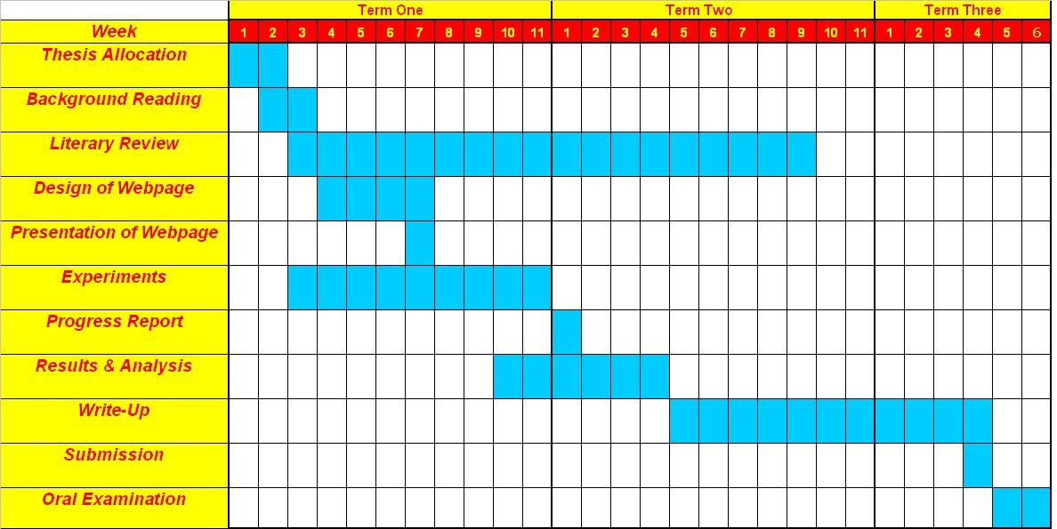
4. Chronology
1991 : decision to build
1996 : design
1998 : deck shape corrected
2000 : contest
2001 : Eiffage wins -> work begins
2002 : foundation and some piers
2003 : last piers
2004 : deck and shrouds

Slide 10
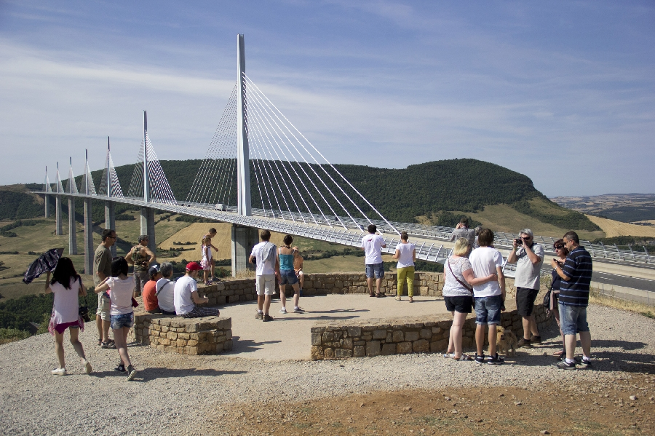
5. The costs
394 millions €
Millau’s economy concerns
Eiffage has the concession until 2080

Slide 11
Vocabulary
cables that support the weight of the bridge come directly from the tower where they are attached
Multi-span cable-stayed bridge :
Road alignment :
Wedge :
Shrouds :
positioning of the road according to standards and constraints.
triangular tool with an inclined plane used to lift objects
Cables that supports the deck

Slide 12
Thank you for your attention

