Slide 1
TITLE OF YOUR PRESENTATION HERE
John Doe – University of Washington, United States of America
Jane Doe – Technical University of Munich, Germany
This area is intended for logos of your institution/university etc.
Delete the box after inserting logos, as it only purpose is to state desirable size of your logo.

Slide 2
PRESENTATION TITLE HERE │ JOHN DOE ET AL.
INTRODUCTION (SCOPE OF THE CONTRIBUTION)
Dear presenter!
All PowerPoint presentations (pptx), together with papers (docx) submitted will be used to prepare adequate proceedings of the Workshop.
Take this in to account when preparing your presentation (namely having special care when using animated objects).
Proceeding will be electronical and will be published/send to you after the Workshop.
Please remember to change the title and authors in the presentation header.

Slide 3
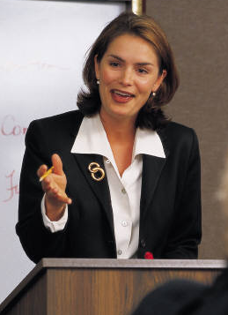
PRESENTATION TITLE HERE │ JOHN DOE ET AL.
INTERMEDIATE SLIDES (THEORY / APPLICATION / CRITICAL APPRAISAL)
The duration of the presentation for a speaker is limited to 15 minutes (22 slides) and for the keynote speaker is limited to 25 minutes (40 slides).
PRESENTER MUST NOT EXCEED ABOVE LIMITATIONS AS EXTRA 5 MINUTES FOR EACH CONTRIBUTION ARE TO BE PROVIDED FOR INTRODUCTION AND QUESTIONS IMMEDAITELY AFTER PRESENTATION.
The presentation computers will not have internet access.
All presentations will be video-recorded.
NO
YES

Slide 4
PRESENTATION TITLE HERE │ JOHN DOE ET AL.
CONCLUSION
Highlight your main conclusions.
Show the reference to the workshop objectives.
Suggest future developments.
PowerPoint presentations should be mailed to
joint-zagreb-workshop@grad.hr no later than February 12th.

Slide 5
PRESENTATION TITLE HERE │ JOHN DOE ET AL.
WE WISH YOU AN EXCELLENT PRESENTATION !!!
John Doe – University of Washington, United States of America
Jane Doe – Technical University of Munich, Germany
This area is intended for logos of your institution/university etc.
Delete the box after inserting logos, as it only purpose is to state desirable size of your logo.

